Slide 1
Volante Technologies Cloud Business Review
Wes Miller
Technical Account Manager
Ed Moran
Account Manager
July 2022

Slide 2
Agenda
Review FinOps Capability Architecture
Value Realization Summary
Health Check
Proposed Use Cases / Next Steps
Review Service offerings
Questions

Slide 3
FinOps Architecture

Slide 4
FinOps Capability Architecture
Update on what customer is using and recommended future state / actions for next period.
Understand Fully Loaded Costs
Enable Real Time Decision Making
Benchmark Performance
Optimize
Usage
Optimize Rates
Align Plans to the Business
Map spending data to the business
Set tag strategy and compliance
Create showback and chargeback reporting
Define budgets and forecasts
Dynamically calculate custom rates and amortization metrics
Provide timely and consistent spend / usage data to all stakeholders
Identify Anomalies
Find & Remove underutilized services
Trending & Variance Analysis
Create Scorecards, metrics & KPI’s
Benchmark internally and against “industry” peers
Rightsizing
Workload Management
Automation
Balance use of various rate types
Select discounts that match your flexibility
Pre-purchase capacity
Custom and Volume Discounts / Sustained Usage
Utilize Marketplace
Licensing Optimization
Mini-Business Cases
Tracking and Trending
Communication strategy
Ongoing reviews with stakeholders on optimization opportunities
Develop a framework for decision making that aligns with the business drivers
Current State
Future State
Notes:
There are many use cases that fall under the Finops principles that we will work with you to develop on your FinOps journey here at Cloudability.

Slide 5
Value Realization Summary

Slide 6
Value Realization Summary
Customer Stated Goals
To be filled
Cloud Use Cases
Opportunities for RI purchase for EC2, RDS & Azure Compute
Opportunities in Rightsizing for EC2,RDS, EBS and Az Compute services
Advanced Credentials not in place for few AWS and Azure sub accounts
More details to be filled
Achievements & Potential Savings to date
RI & Savings Plans
RI & Savings Plans
Anomaly Detection
AWS & Azure Rightsizing
EC2 RI Coverage rate peaks at 29%
Opportunity for purchase around all services:
EC2 : $146K
RDS : $40.5K
Az Compute: $415.2K
Since last 30 days,6 anomalies were identified.
Total Unusual spend of $ 511
Potential savings-$723.7K p/a
Rightsizing:
EC2 $206.7K p/a
EBS $65.7K p/a
RDS $157.7K p/a
Az Compute $281.1K p/a
Idle Opportunities:
EC2 $5.8K p/a
EBS $5.8K p/a
Az Compute $684 p/a

Slide 7
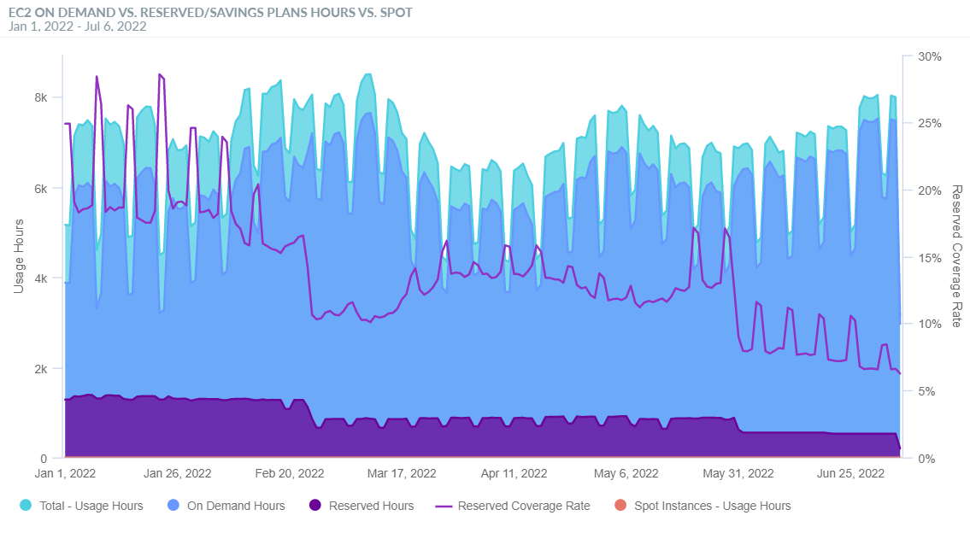
EC2 RI and SP Coverage
1
2
2
Savings Opportunity
SP / RI coverage peaked at 29%
Now in decline. Current reserved coverage rate is at 6% - more commitment needed here
Recommended coverage rate 75-85%
© 2021 Apptio, All rights reserved (v1909-1)

Slide 8
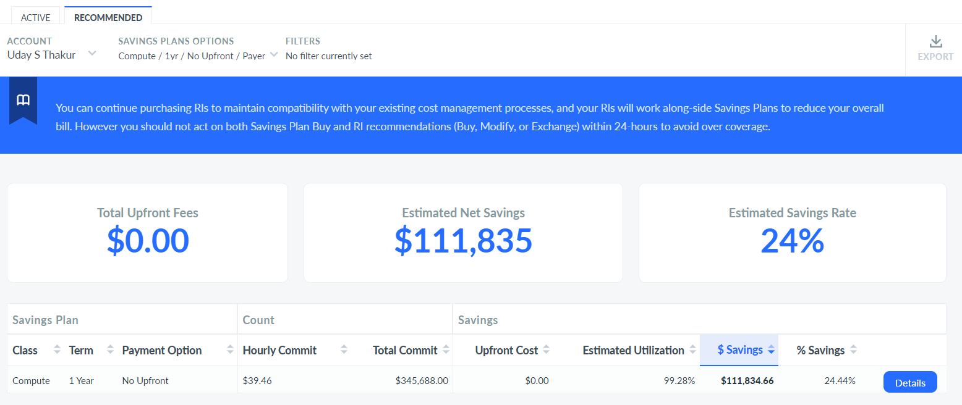
AWS Savings Plan Opportunity
3
1
2
1
Compute Type Savings Plan Opportunity
Compute Type Recommended
Estimated Net Savings of $111.8K
No Upfront /1yr selected – opportunity for 3 year (depending on workload and customer)

Slide 9
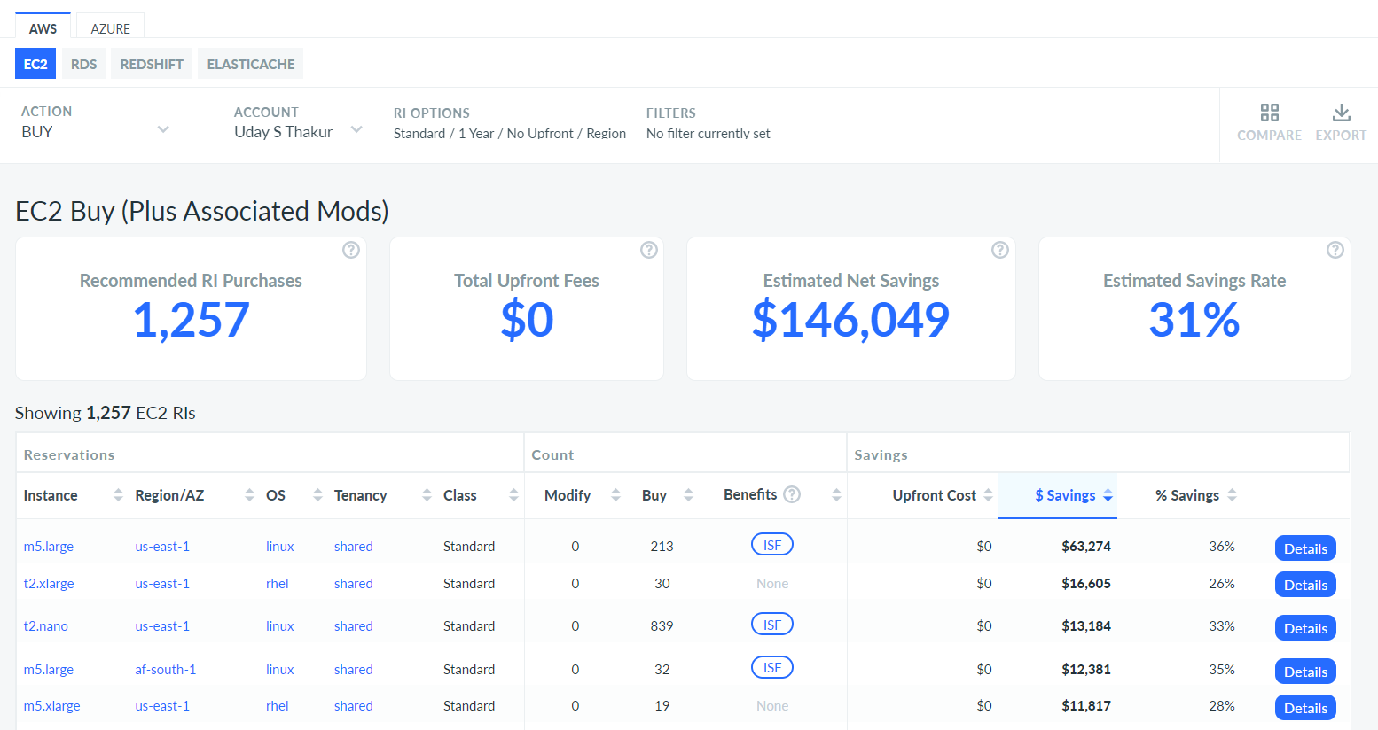
AWS EC2 Reserved Instance Opportunity
1
2
AWS EC2 RI Opportunity
1. $146K potential savings here for EC2
2. These are the Top 5 recommendations based on 1 year No Upfront Cost

Slide 10
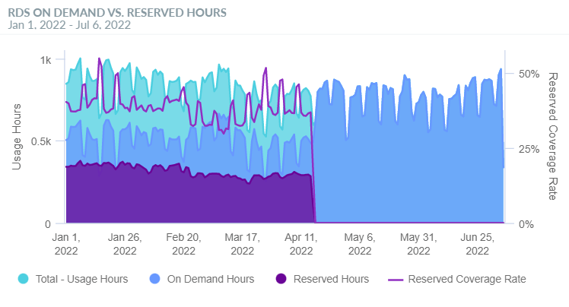
RDS Reserved Coverage
1
2
1
Immediate Savings Opportunity
RI Coverage peaked at 55%(Jan 15th, 2022)
Post April 15th , only On-Demand Usage is seen
Recommended coverage rate 75-85%

Slide 11
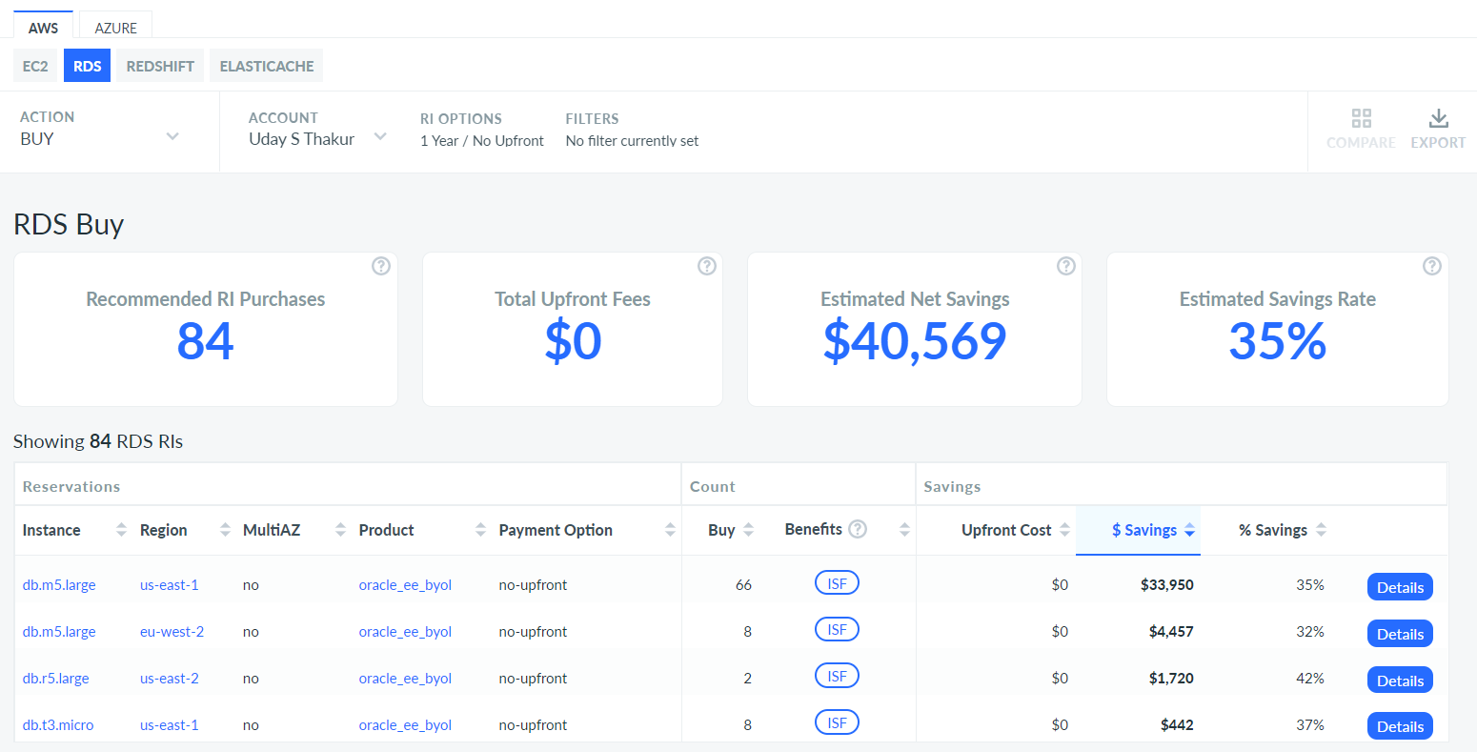
AWS RDS Reserved Instance Summary
1
1
2
2
AWS RDS Reserved Instance Opportunity
No Upfront Recommended
Estimated savings of $40.5K

Slide 12
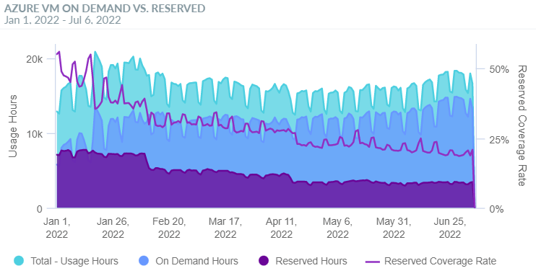
Azure Compute RI Coverage
1
2
Savings Opportunity
SP / RI coverage peaked at 56%
Now in decline - more commitment needed here
Recommended coverage rate 75-85%
© 2021 Apptio, All rights reserved (v1909-1)

Slide 13
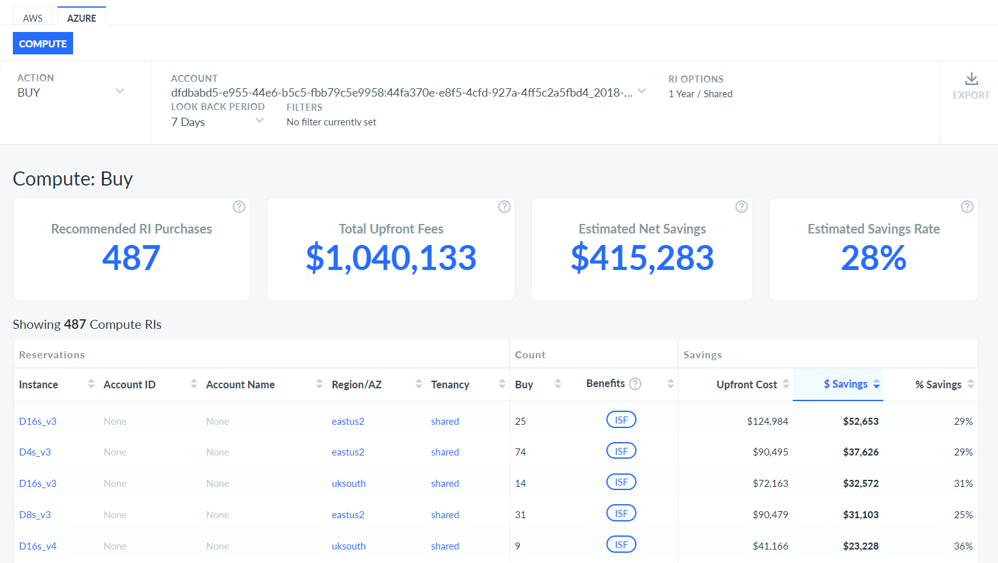
Azure Compute Reserved Instance Opportunity
1
1
Reserved Instance Opportunity
Estimated savings of $415.2K

Slide 14
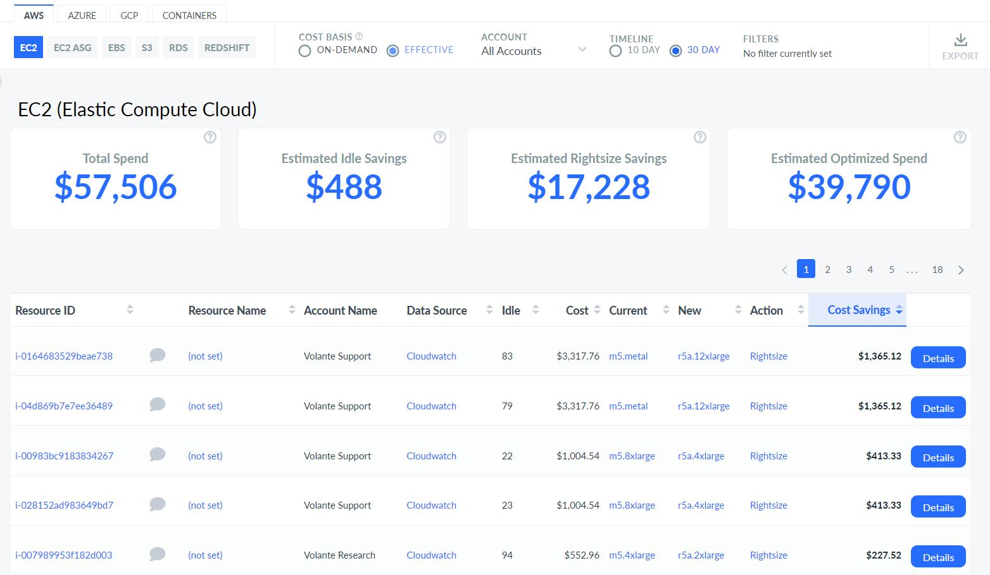
EC2 Rightsizing Details
3
3
1
2
Rightsizing Savings Recommendations
Rightsizing Savings Recommendations
EC2 Idle Instances Savings of up to $488 = $488 x 12 = $5.8K p/a
Rightsizing Opportunity of up to $17.2K = $17.2K x12 = $206.7K p/a
Based on 30 days / Effective (taking RI/SP into account)

Slide 15
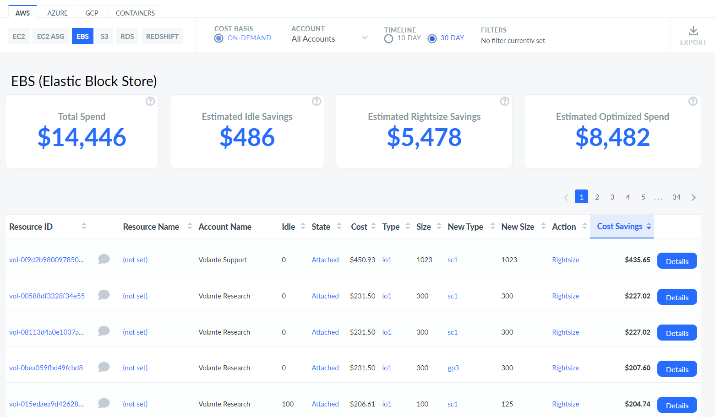
EBS Rightsizing Details
3
1
2
Rightsizing Savings Recommendations
EBS Idle Instances Savings of up to $486 = $486 x 12 = $5.8K p/a
Rightsizing Opportunity of up to $5.4K = $5.4K x12 = $65.7K p/a
Based on 30 days

Slide 16
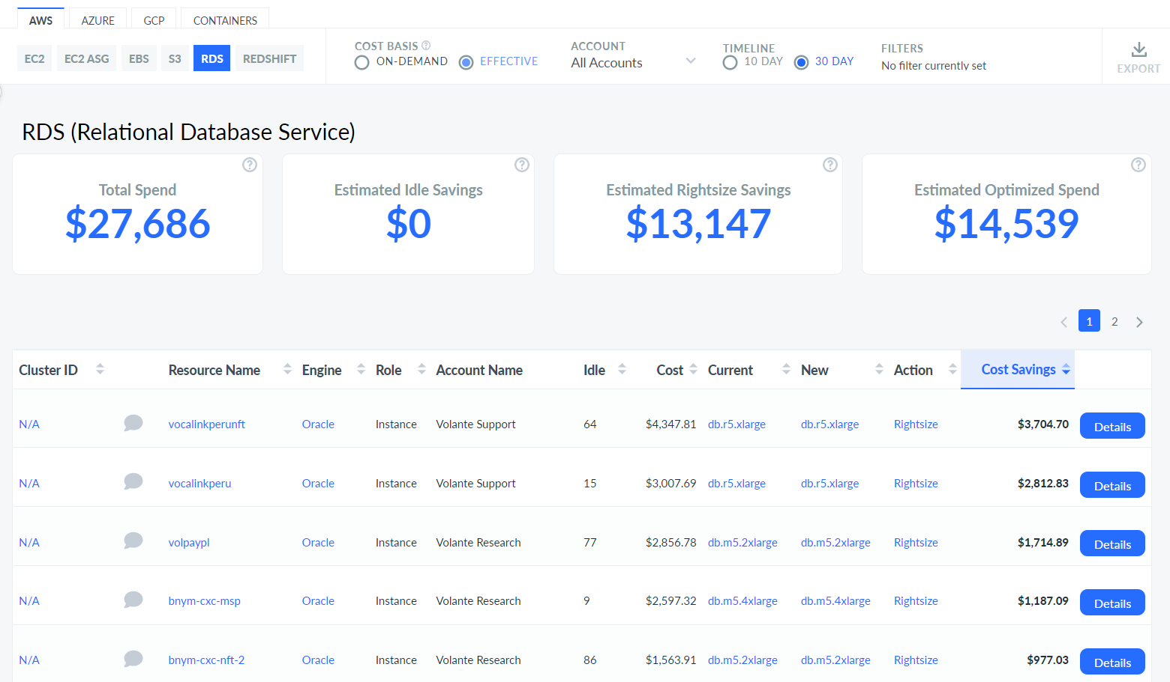
RDS Rightsizing Details
3
3
1
2
Rightsizing Savings Recommendations
RDS Idle Instances Savings of up to $0
Rightsizing Opportunity of up to $13.1K = $13.1K x12 = $157.7K p/a
Based on 30 days / effective

Slide 17
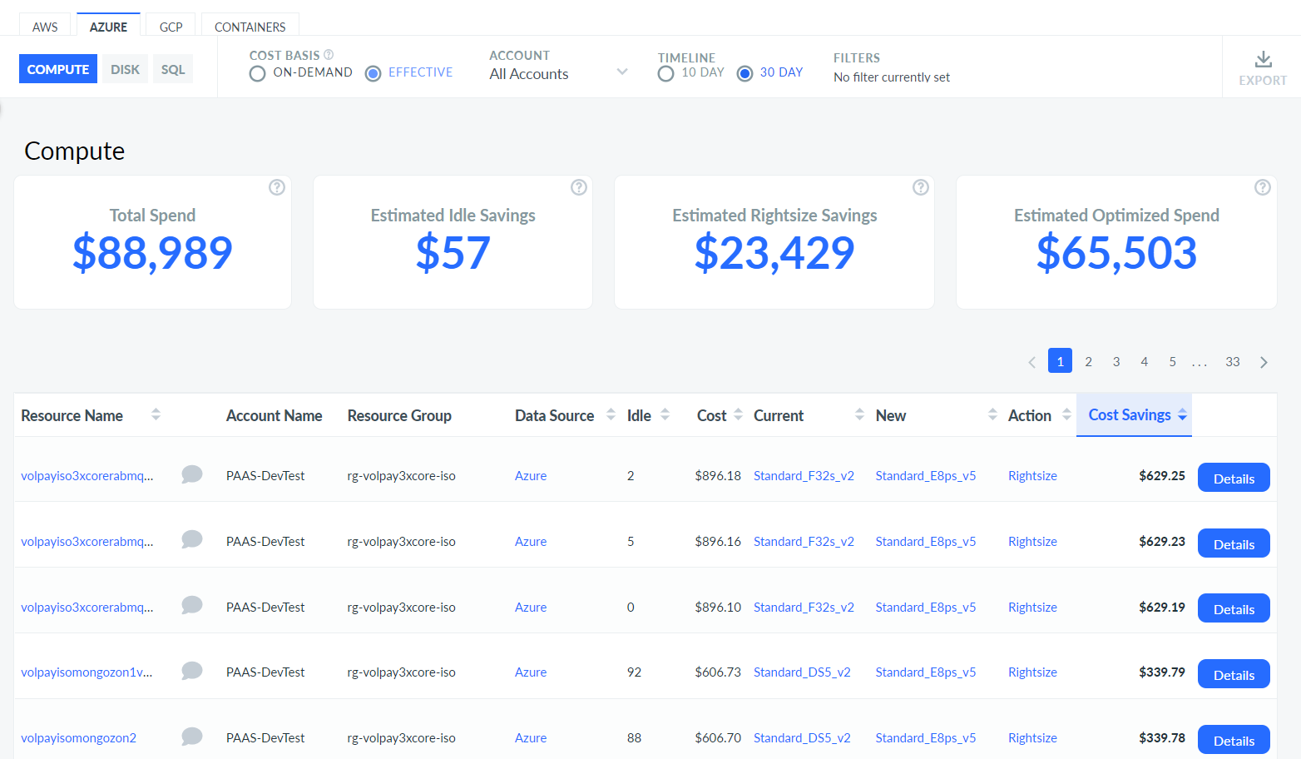
Azure Compute Rightsizing Details
3
3
1
2
Rightsizing Savings Recommendations
Azure Idle Instances Savings of up to $57 = $57 x 12 =$684 p/a
Rightsizing Opportunity of up to $23.4K = $23.4K x12 = $281.1K p/a
Based on 30 days / effective

Slide 18
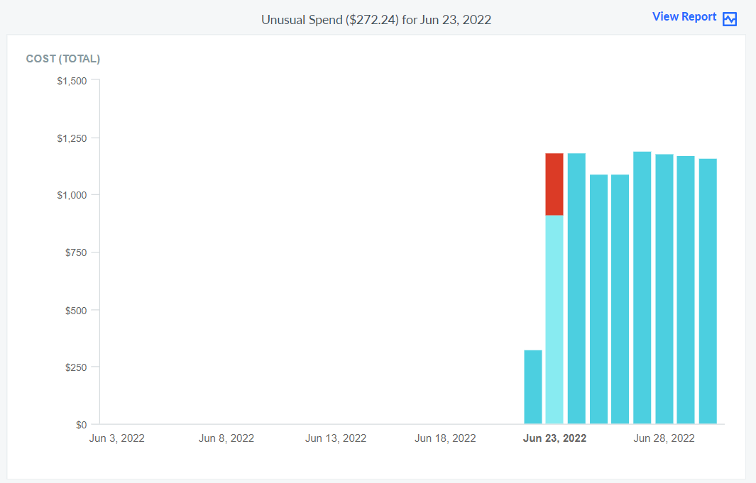
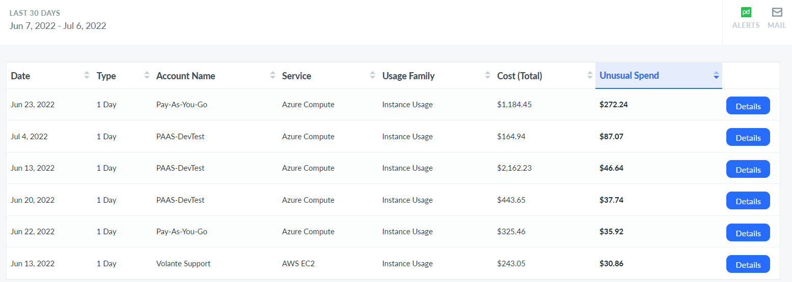
Anomaly Detection
2
1
4
3
Anomaly Detection
6 anomalies detected over the past 30 days
Was this an anomaly you picked up on or expected spend
Details will show you anomaly type and point you to a report for further investigation per 2
Ensure subscriptions to anomaly alerts either via Email or Pager Duty

Slide 19
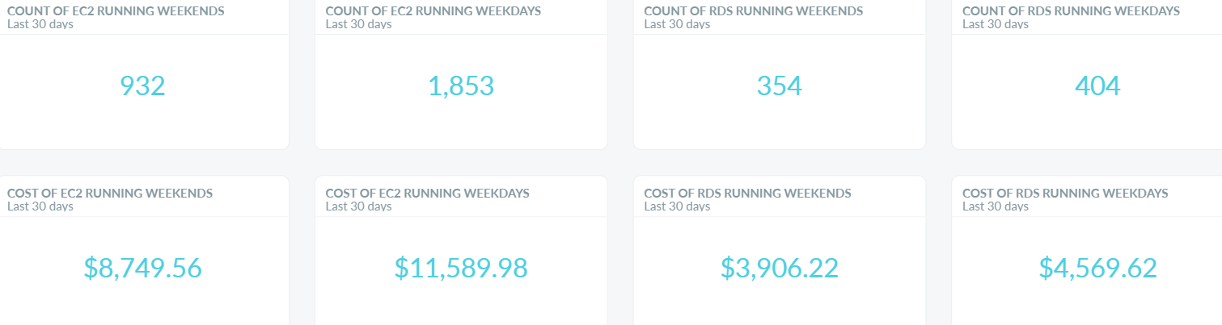
Weekend vs Weekday Usage
1
2
Weekend vs Weekday Usage Costs
Less workloads running on Weekends than Weekdays (this includes all AWS Accounts)
Similarly, for RDS, 354 on a weekend is less than on Weekdays. (this includes all AWS Accounts)
Where possible seek to power off workloads. Better optimization to be had doing this.

Slide 20
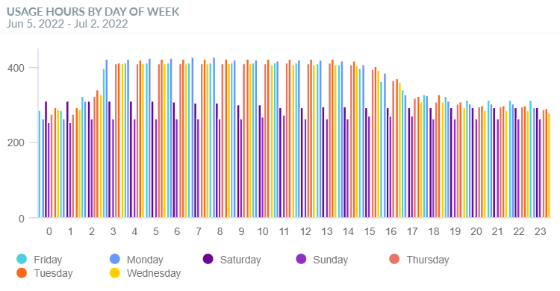
Elasticity / Rightiming of EC2
1
Elasticity / Right-timing of EC2
Your EC2 use on weekends is static

Slide 21
Health Check

Slide 22
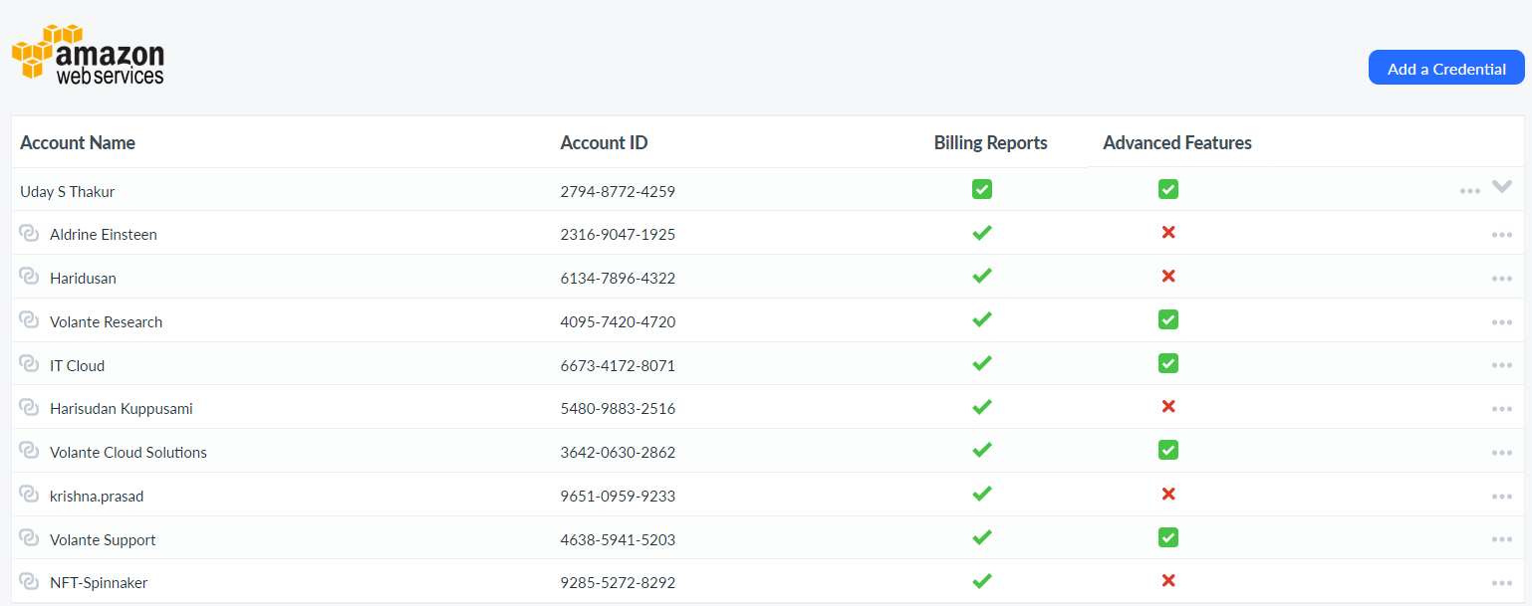
AWS Credentialing
1
2
Credentialling
Master Payer Account credentialled well. Be mindful of changes to SCPs affecting this
Ensure Linked accounts have credentials – better usage metrics available in tool and better Rightsizing recommendations

Slide 23
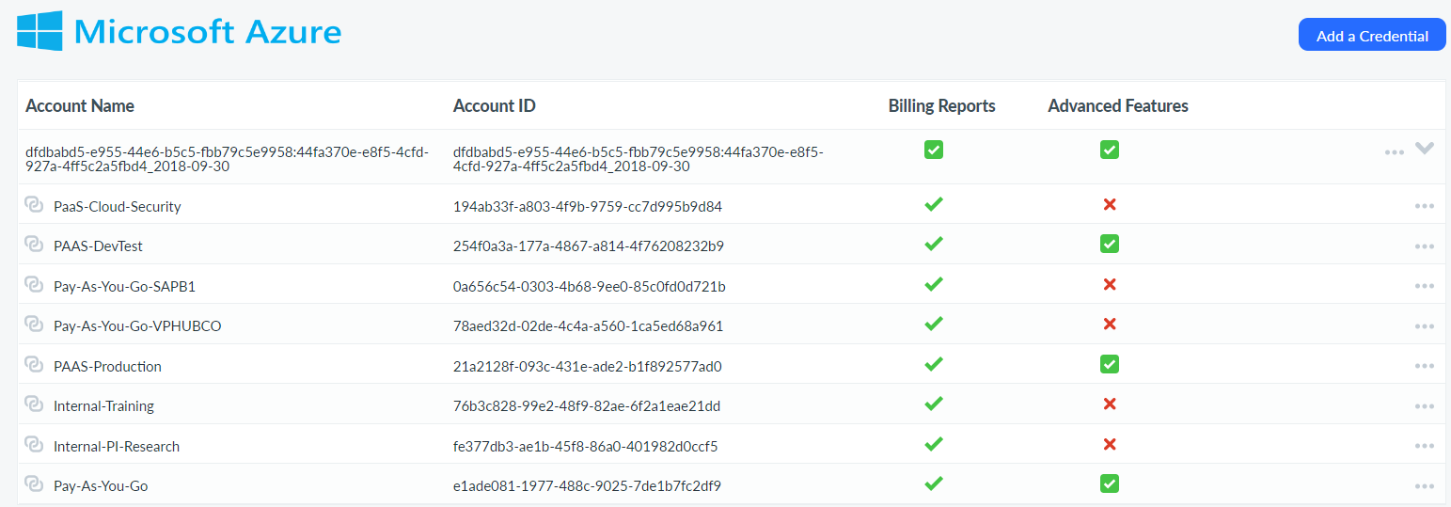
Azure Credentialing
1
2
Credentialling
Note expiry of of EA API key – book meeting to ensure its renewed before it expires. Work with your TAM to move to new API if not already done.
Ensure Subscriptions are advance credentials – this provides resource group tags and rightsizing metrics if not in place use Management Groups to automate this capability for large numbers of subscriptions.

Slide 24
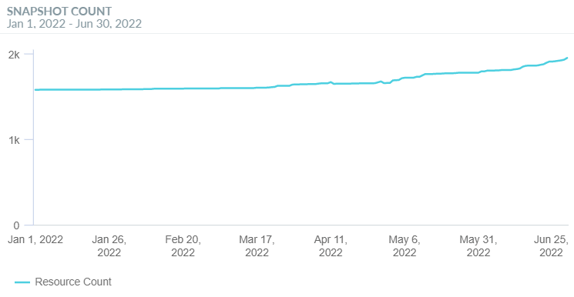
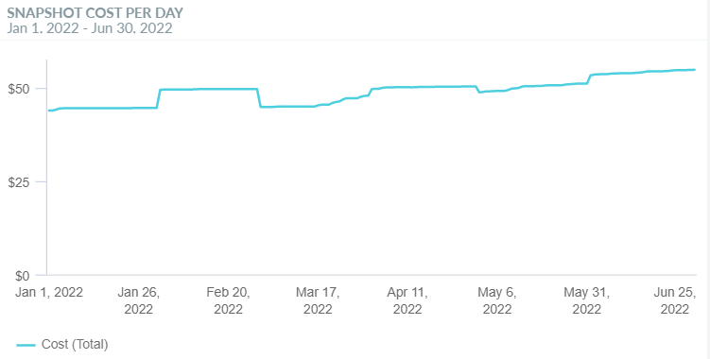
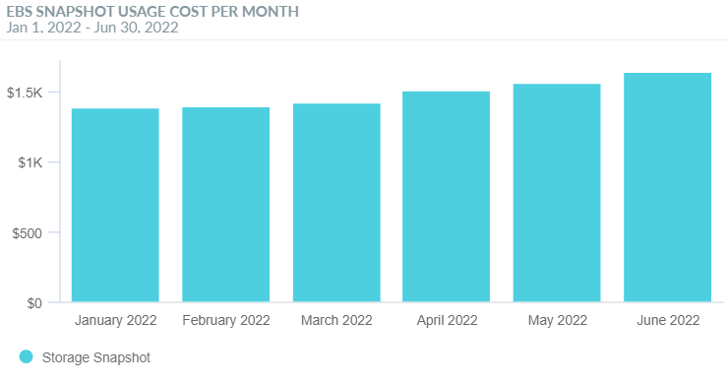
EBS Snapshots
Potential Quick Wins
Cost of EBS snapshots is growing from $1.3K in Jan to $1.6K in June.
When was last Snapshot Clean-up performed?

Slide 25
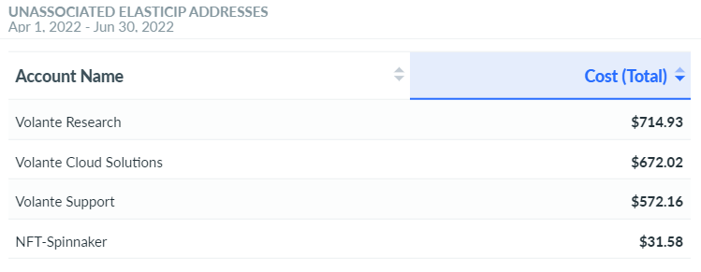
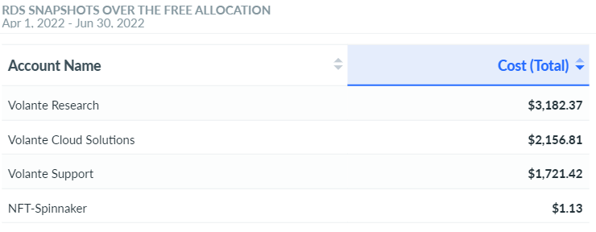
Other Idle Resources Summary
1
2
Potential Quick Wins
Approximately $1.9K worth of unused Elastic Ips. IP address are free if they’re attached to an instance but if they’re not attached, they do cost.
Approximately $7K worth of RDS snapshots. RDS snapshots are free if the snapshot size is equivalent the size of the RDS, any additional snapshot past the RDS size will incur cost.

Slide 26
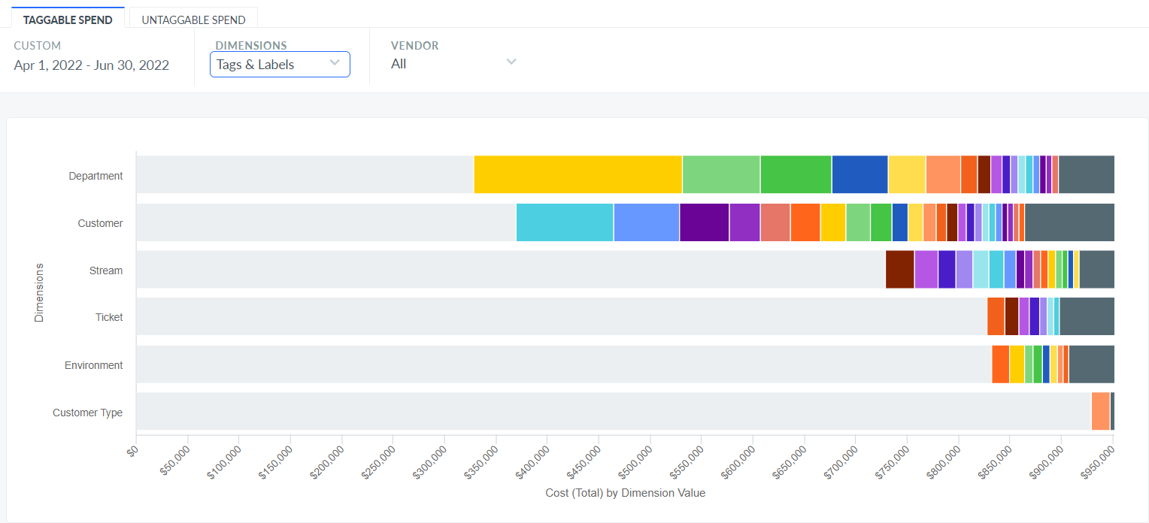
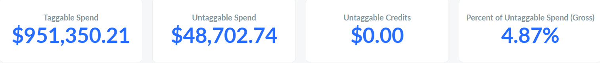
Taggable vs. Untagged Spend
1
2
3
Taggable vs Untaggable Spend
Currently, tagging needs work as tagging visibility will help trace and allocate cloud spend more effectively.
$951.3K of Taggable Spend in the last 3 months. (April 2022 – June 2022)
$48.7K of Untaggable Spend in the last 3 months. (April 2022 – June 2022)

Slide 27
Proposed Use Cases

Slide 28
First 6 Months – Proposed Use Cases
TAM : Use if priority is Cost Visibility or both
Tagging
Ensure tagging policies in place and governance reporting enabled
Ensure mapping pulling tags into Cloudability
Visibility
Create Views per domain / cost centre / business unit / construct – allocate to users
Create common shared reports and dashboards – share org wide or individual
Agree on cost metric / currency in tool
Anomalous spend
Ensure subscription to keep abreast of inconsistent spend trends
Business Mapping
Augment and enrich your cloud data / tags / information with your business logic.
Next Steps
Crawl, Walk, Run. Its not a race. Start slow and build on your commitments.
Assign Actions to individuals – the who
Timeline to achieve goals - the when
Do you have sufficient resources to action – if the who doesn’t exist?
Can Apptio help you achieve this?

Slide 29
First 6 Months – Proposed Use Cases
TAM : Use if priority is Cost Optimization or both
Non Production
Power off non essential workloads outside business hours and on weekends
Do not power on. Let DevSecOps power on resources
EBS / Azure Disk & Google GPD
Cleanup unattached and Idle Volumes
Cleanup Snapshots > 30 days old
RDS / SQL / EC2 / VM / GCE
Terminate Idle Instances
Rightsize underutilized resources
Savings Plans / Reserved Instances/ Committed Use Discounts
Aim for 75-85% coverage or what you are comfortable with.
Put in place for all services where available
Next Steps
Crawl, Walk, Run. Its not a race. Start slow and build on your commitments.
Assign Actions to individuals – the who
Timeline to achieve goals - the when
Do you have sufficient resources to action – if the who doesn’t exist?
Can Apptio help you achieve this?

Slide 30
Service Offerings

Slide 31
Cloudability Service Offerings
Sales to speak to. This should be updated with new service offerings post Aspire.
1
2
3
4
FinOps Workshop
Strategy and Governance
Geared towards IT executives and Cloud Stakeholders needing to learn the strategy and best practices to build a highly effective Cloud Program
Outcomes
Understand how to build a Cloud Strategy Understand FinOps Best Practices Understand Cloud Organizational Readiness
Advisory – Visibility and Cost Allocation
Inform
Establish FinOps visibility activities into the organization and setup the right organizational structure to manage Cloud Financial Management in your organization.
Outcomes
Define Personas, Roles, and Responsibilities Use case design / validation Tag strategy design Reporting taxonomy Establish foundational cost transparency and allocation
Advisory – Cost Optimization
Optimize
Develop a comprehensive cloud optimization strategy geared for immediate cost savings. Included are a set of optimization recommendations aligned with the business while starting to enable accountability across the org.
Outcomes
Save 5% - 15%+ Immediate Return on Investment Re-distribute savings Enable your team on FinOps Best Practices
Cloudability Guided Services
Operate
Certified Cloudability experts with multi-cloud expertise that can help mentor your team on all the capabilities of the platform
Outcomes
Accelerate Cloud goals Increased user adoption Become a Cloudability expert
2 Business Days
Fixed Fee
8 Business Weeks
Fixed Fee
8 Business Weeks
5%, 10%, 15% FTE
6 Month, 12 Month Terms

Slide 32
Questions?

